Slide 1
THANK YOU FOR DOWNLOADING!
Hope it helps with your presentations!
In case the embedded fonts don’t work, here are the download links:
Mamba
https://fontshub.pro/font/mamba-download
Holla Summer https://freedesignresources.net/holla-summer-script-font/
Anton https://fonts.google.com/specimen/Anton

Slide 2









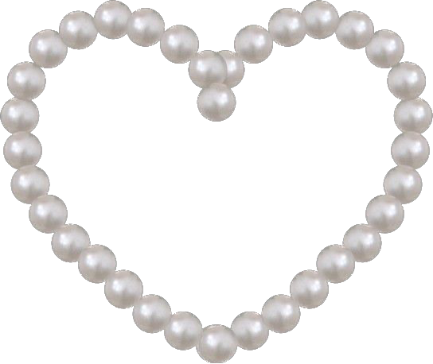


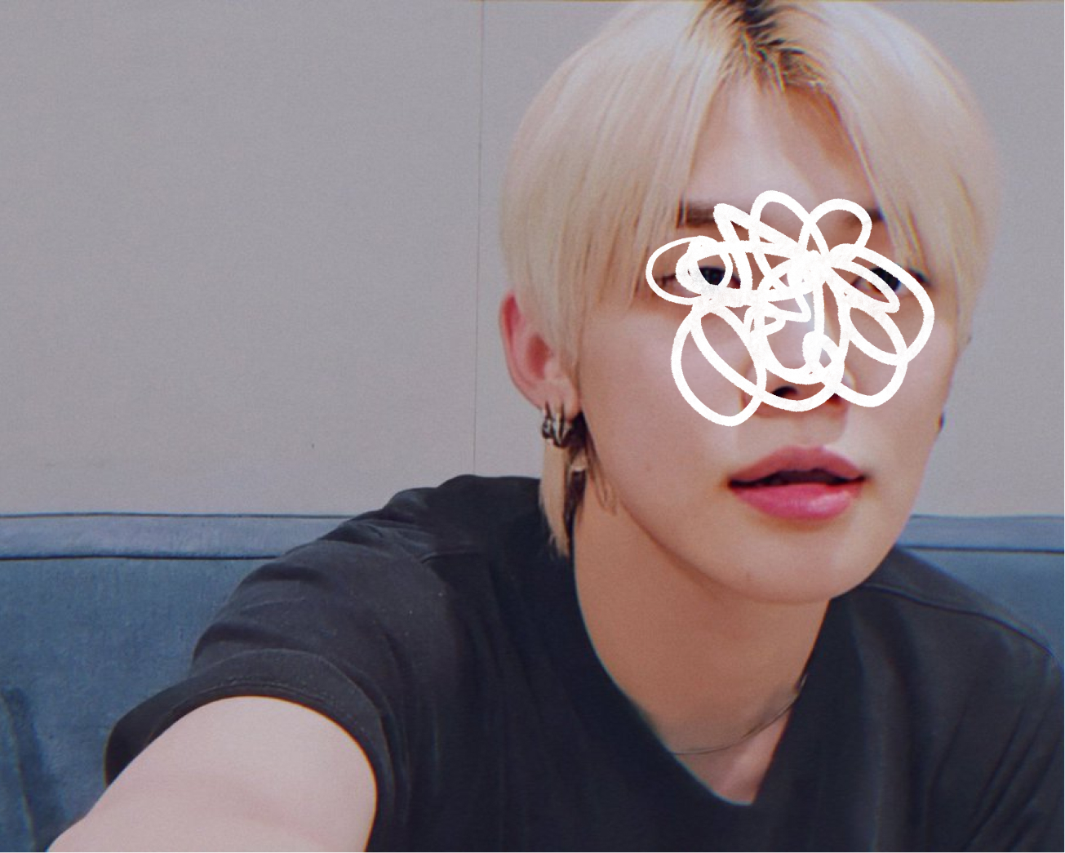


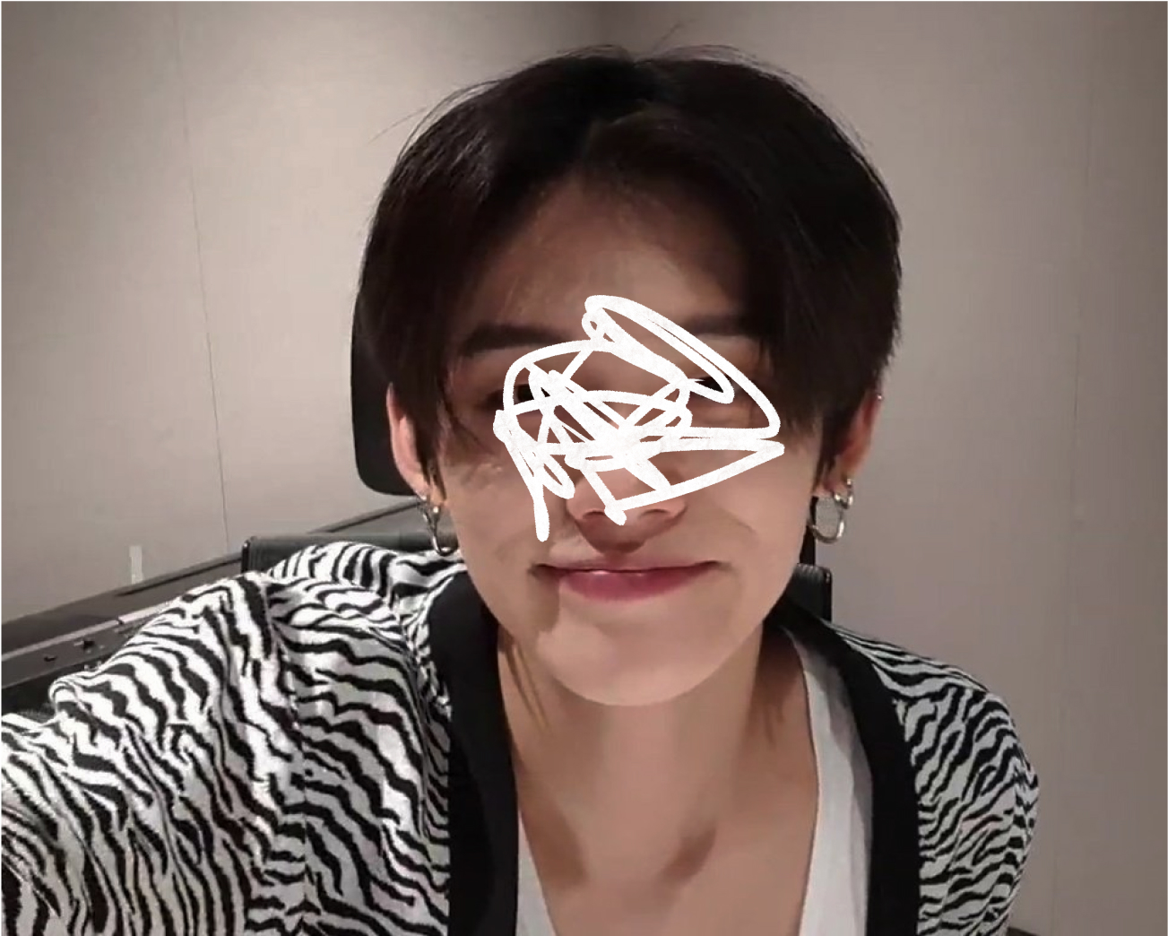





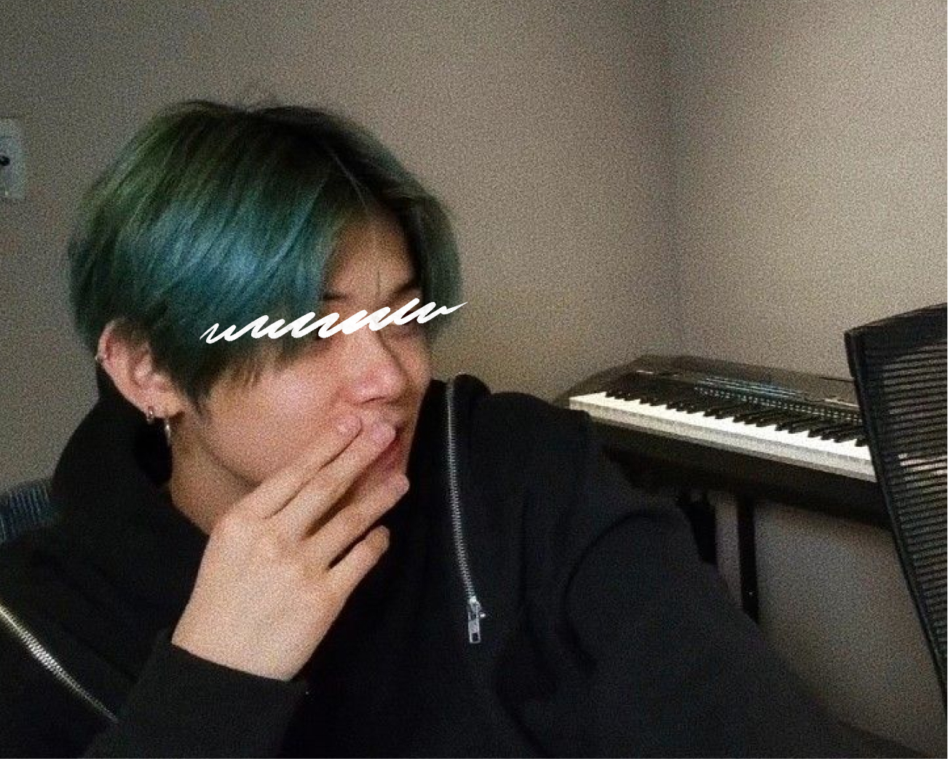
WHY
YOU
SHOULD
DATE
JAY
by @dstoryco
23 y.o.
180cm
enfp

Slide 3



ABOUT
23 y.o.
About.
180cm
enfp
virgo
love
language
quality
time

Slide 4
ABOUT
23 y.o.
180cm
enfp
About.
virgo
love
language
quality
time

Slide 5
ABOUT
23 y.o.
180cm
enfp
virgo
love
language
About.
quality
time

Slide 6
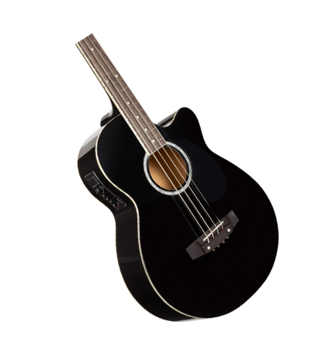
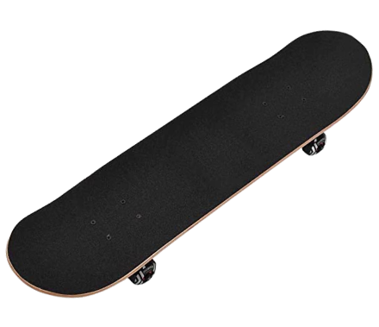
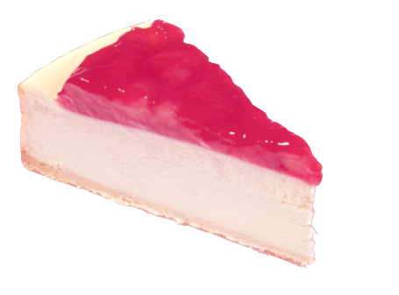
INTERESTS
Interests.
Guitar
Baking
Skating

Slide 7




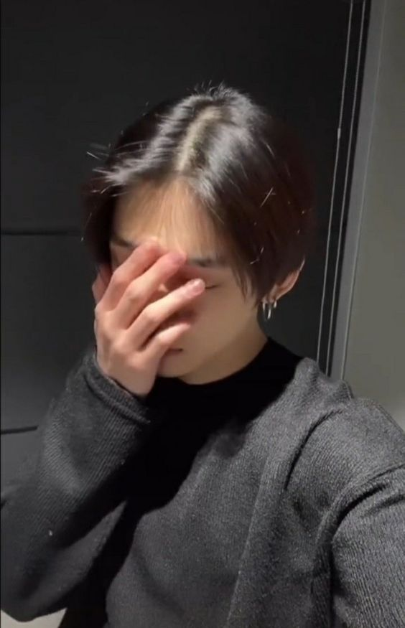





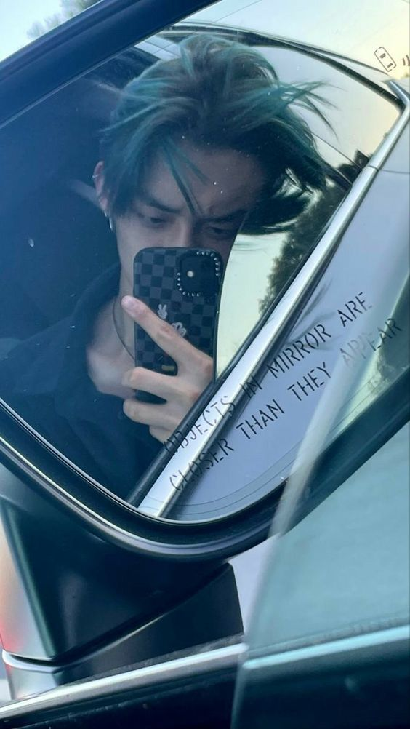
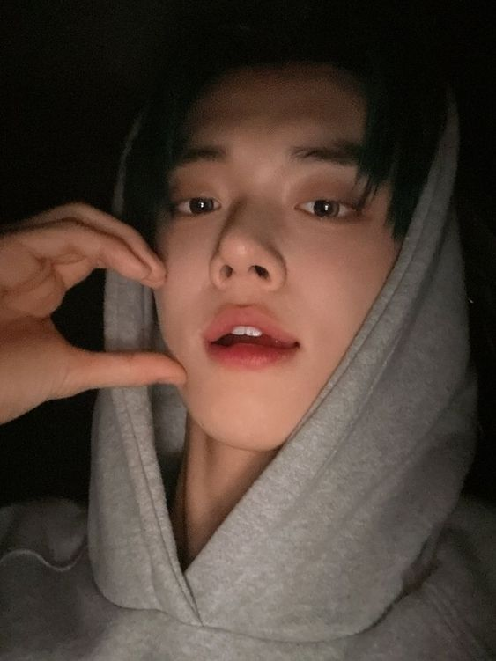

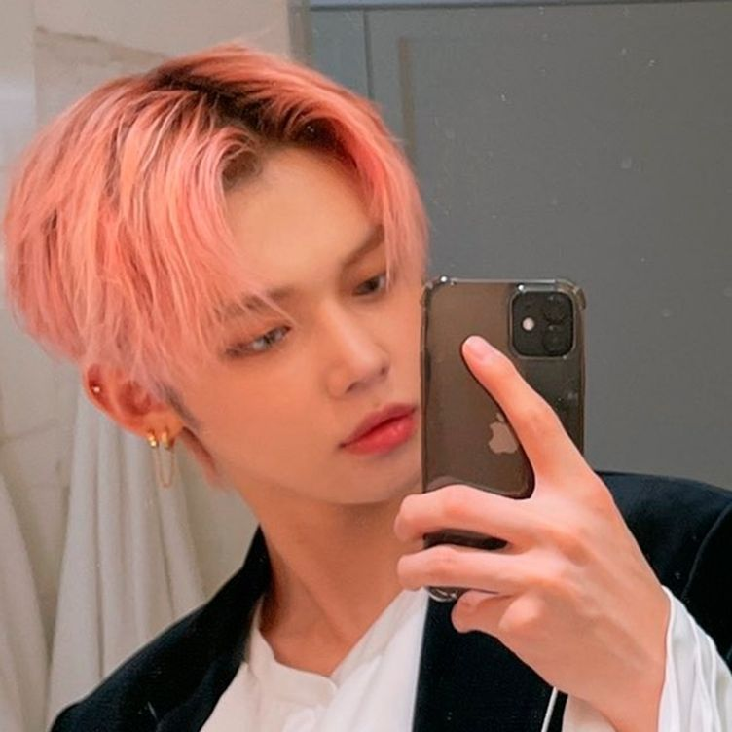
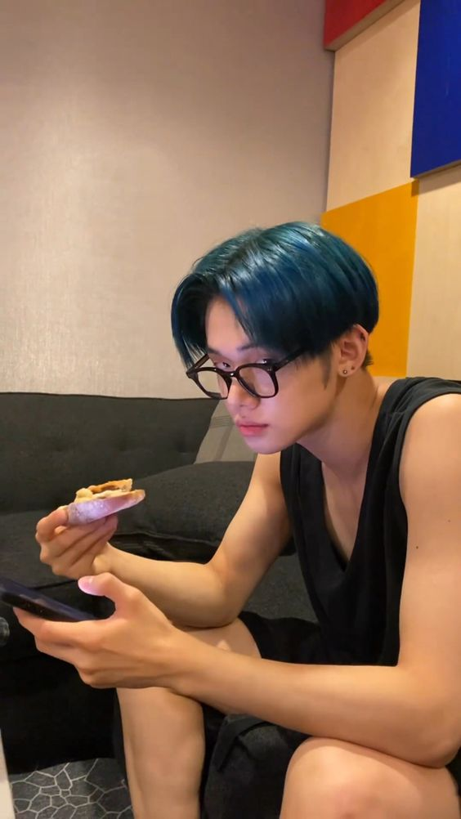


PROS
Will take amazing photos of you

Slide 8
PROS
Makes an amazing tiramisu

Slide 9
PROS
Will spoil tf out of you

Slide 10
CONS
May bore you with car facts

Slide 11
CONS
Sleeps a lot, may not reply for a few hours

Slide 12
CONS
Will love his dog more than you

Slide 13
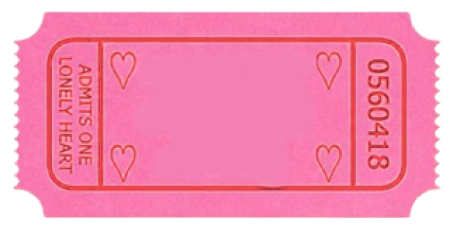




ONE
DATE
Be his valentine?
no
yes
dm him: yawnzzn or 123-456-789

Slide 14


